Slide 1

EXPANDED DISPATCH ORGANIZATION
Unit 1

Slide 2

Objectives
Describe the purpose and structure of the dispatch organizations (established and expanded).
Demonstrate the use of established dispatch ordering channels.
Describe the unique language of dispatch.
Describe unit ID components and dispatch channels as they relate to IROC.
D-110 Unit 1: Dispatch Organization

Slide 3
Objectives
Describe unit ID components and dispatch channels as they relate to IROC.
Describe the EDRC’s roles and responsibilities and their limits of authority.
Describe the importance of documentation and recordkeeping.
D-110 Unit 1: Dispatch Organization

Slide 4
Established Dispatch Primary Mission
To provide safe, timely, and cost-effective coordination of emergency response within a specific geographic area
(local, geographic and national).
D-110 Unit 1: Dispatch Organization

Slide 5
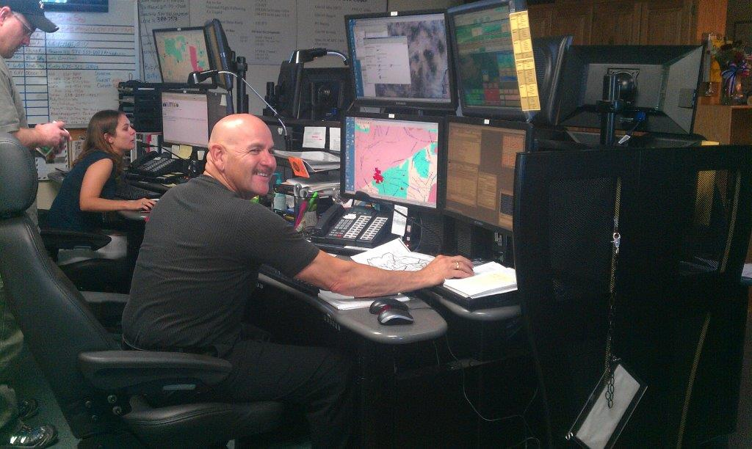
Established Dispatch
Local agency or interagency dispatch centers
Daily duties
Aircraft
Intelligence
Initial attack
Resource
mobilization and
tracking
Telephone and radio traffic
D-110 Unit 1: Dispatch Organization

Slide 6
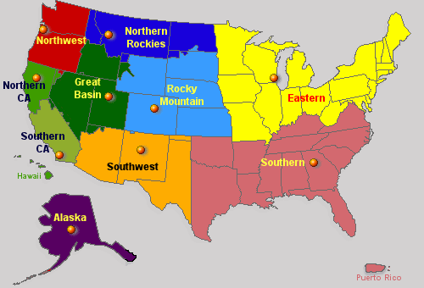
Established Dispatch
Geographic Area Coordination Centers (GACCs)
Focal point for requests not filled at the local level.
Provide intel, predictive svc. and related products for geographic area.
D-110 Unit 1: Dispatch Organization

Slide 7
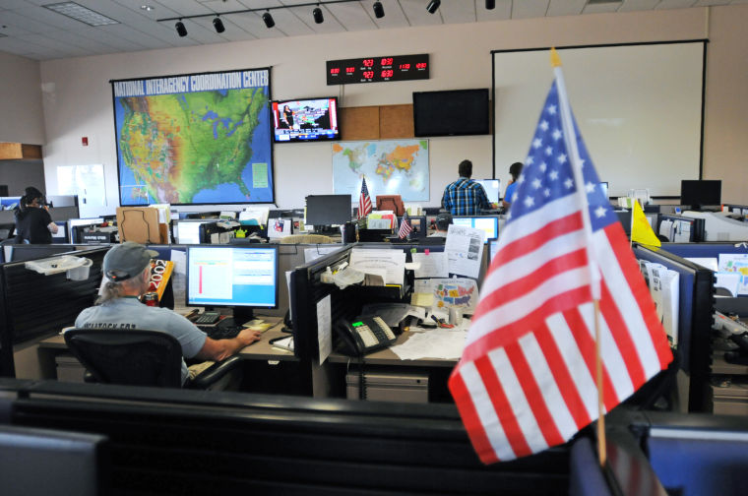
Established Dispatch
National Interagency Coordination Center (NICC)
National focal point for requests not filled at the original geographic level.
Provide intel,
predictive svc. and
related products for
national community.
D-110 Unit 1: Dispatch Organization

Slide 8
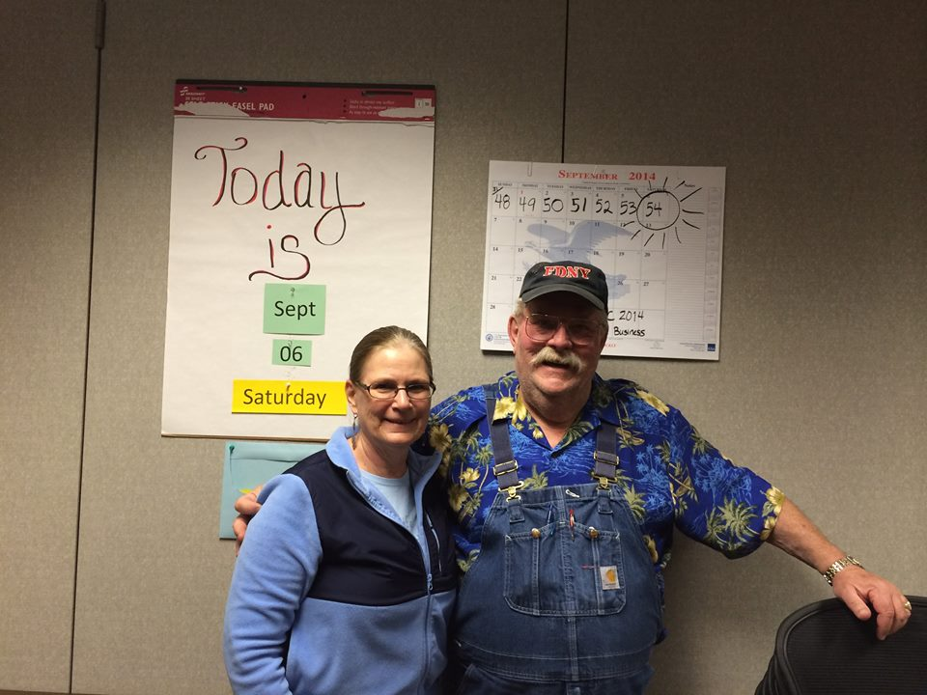
Expanded Dispatch
Created to handle the increased workload on large, multiple small, or complex incidents.
D-110 Unit 1: Dispatch Organization

Slide 9

EDRC Expanded Dispatch Recorder
Processes resources orders.
Relay pertinent information.
Track resources and document.
Participate in briefings.
Relay issues to EDSP.
D-110 Unit 1: Dispatch Organization

Slide 10

EDSD Expanded Dispatch Support Dispatcher
Mobilize resources in one or more area.
Use or direct use of electronic resource tracking system (IROC)
Provide guidance to EDRCs.
Relay issues to EDSP.
D-110 Unit 1: Dispatch Organization

Slide 11
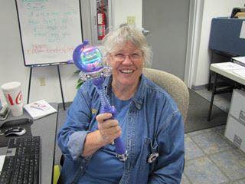
EDSP Expanded Dispatch Supervisory Dispatcher
Supervises EDSDs
and EDRCs.
Orders additional dispatchers.
Provides training.
Coordinates
functional areas.
Conducts briefings.
Liaison.
D-110 Unit 1: Dispatch Organization

Slide 12

CORD - Coordinator
Assigned in complex situations involving Multiple Area Coordination (MAC) groups or multiple expanded dispatch organizations.
Liaison between all units (IA, expanded, MACs, etc.).
Schedules and attends briefings with all units involved.
D-110 Unit 1: Dispatch Organization

Slide 13


Expanded Dispatch Coordinator
CORD
Expanded Dispatch Supervisor
EDSP
Expanded
Support Dispatcher
EDSD
Expanded
Support Dispatcher
EDSD
Expanded
Support Dispatcher
EDSD
Expanded
Dispatch Recorder
EDRC
Expanded
Dispatch Recorder
EDRC
Expanded
Dispatch Recorder
EDRC
D-110 Unit 1: Dispatch Organization

Slide 14

INCIDENT
Dispatch Center
Geographic Area Coordination Center
National Interagency Coordination Center
Geographic Area Coordination Center
Dispatch Center
Sending Agency
D-110 Unit 1: Dispatch Organization

Slide 15
NICC
NWCC
(Parent)
OR-COC
(Child-Neighbor)
OR-EIC
(Child)
WA-CCC
(Child-Neighbor)
D-110 Unit 1: Dispatch Organization
01-15-D110-EP

Slide 16

Why do dispatchers have a unique language?
NIFC
ETA/ETD
UA
NECC
GACC
SFO
D-110 Unit 1: Dispatch Organization

Slide 17
Glossary of Common Terminology
Unit Identifiers
NV-CCD = Nevada, Carson City, BLM
Position Codes
EDRC = Expanded Dispatch Recorder
ORDM = Ordering Manager
FFT1 = Firefighter, Type 1
Acronyms
ETA = Estimated Time of Arrival
SOP = Standard Operating Procedure
UTF = Unable to Fill
NIFC
NECC
GACC
SFO
D-110 Unit 1: Dispatch Organization

Slide 18
Communications
Outside Contacts
Incoming resources
Expanded dispatchers on other units
IA and GACC dispatchers
Local Cache
Ordering Manager (ORDM)
Buying Team
Supply Unit Leader (SPUL) or Logistics Section Chief (LSC)
Ground support/ transportation
Compact personnel
Contractors / vendors
Interagency Resource Representative (IARR)*
Local management and officers*
Public*
Public Affairs/Information Officers*
Media*
D-110 Unit 1: Dispatch Organization

Slide 19
Documentation
Why Document?
Used for legal proceedings
Follow up
Provides record of significant events
Host unit will reference information after expanded has demobed
D-110 Unit 1: Dispatch Organization

Slide 20
Recordkeeping
IROC is the official system of record
Document important information in IROC
Keep General Messages
Keep Shift Briefs
Local Protocol
D-110 Unit 1: Dispatch Organization

Slide 21
Preparing for an assignment
Make sure you have your resource order
Contact host unit for local information (dress code, lodging, etc.)
D-110 Unit 1: Dispatch Organization

Slide 22
Objectives
Describe the purpose and structure of the dispatch organizations (established and expanded).
Demonstrate the use of established dispatch ordering channels.
Describe the unique language of dispatch.
D-110 Unit 1: Dispatch Organization

Slide 23
Objectives
Describe unit ID components and dispatch channels as they relate to IROC.
Describe the EDRC’s roles and responsibilities and their limits of authority.
Describe the importance of documentation and recordkeeping.
D-110 Unit 1: Dispatch Organization

